Slide 1
Redgate DevOps Discovery: Navigating the Database Landscape

Slide 2




About me
Huxley Kendell
Solutions Engineer
he/him
https://www.linkedin.com/in/huxley-kendell

Slide 3

About me
David Ong
Sales Team Manager
he/him
https://www.linkedin.com/in/davidongalpha/

Slide 4
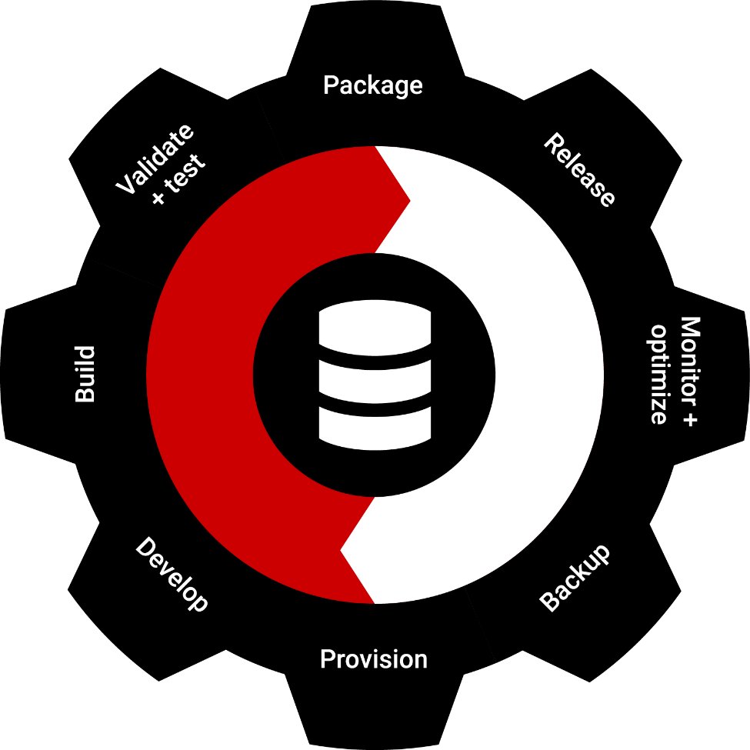
“DevOps is the union of people, process, and products to enable continuous delivery of value to our end users.” Donovan Brown, Partner Program Manager, Azure Incubations, Microsoft
Notes:
Steve (1.5 minutes):
There are many definitions, but this one stands out to me
This says “Devops is the continuous delivery of value to end users”
That’s what we need to do. Get value to users, not just close our ticket.
The middle part notes we all need to work together using whatever tools, departments, frameworks, methodology, process, etc.

Slide 5

25 years of navigating the database landscape with the community
Redgate is the leading provider of software solutions for End-to-end Database DevOps. With 25 years of experience, the data community trusts us to help as they balance speed to market, standardization across teams and the safeguarding of business-critical data.
Notes:
Elevator pitch for Redgate: At Redgate, we build tools to help you build and operate database software. We’ve spent the last decade working to research, design, and built Database DevOps tools to allow you to help your teams more easily work with database software. We have built the best-of-breed, industry standard software for schema comparison, as well as script deployment with our SQL Compare and Flyway technologies. We also have a premier monitoring solution with SQL Monitor.

Slide 6










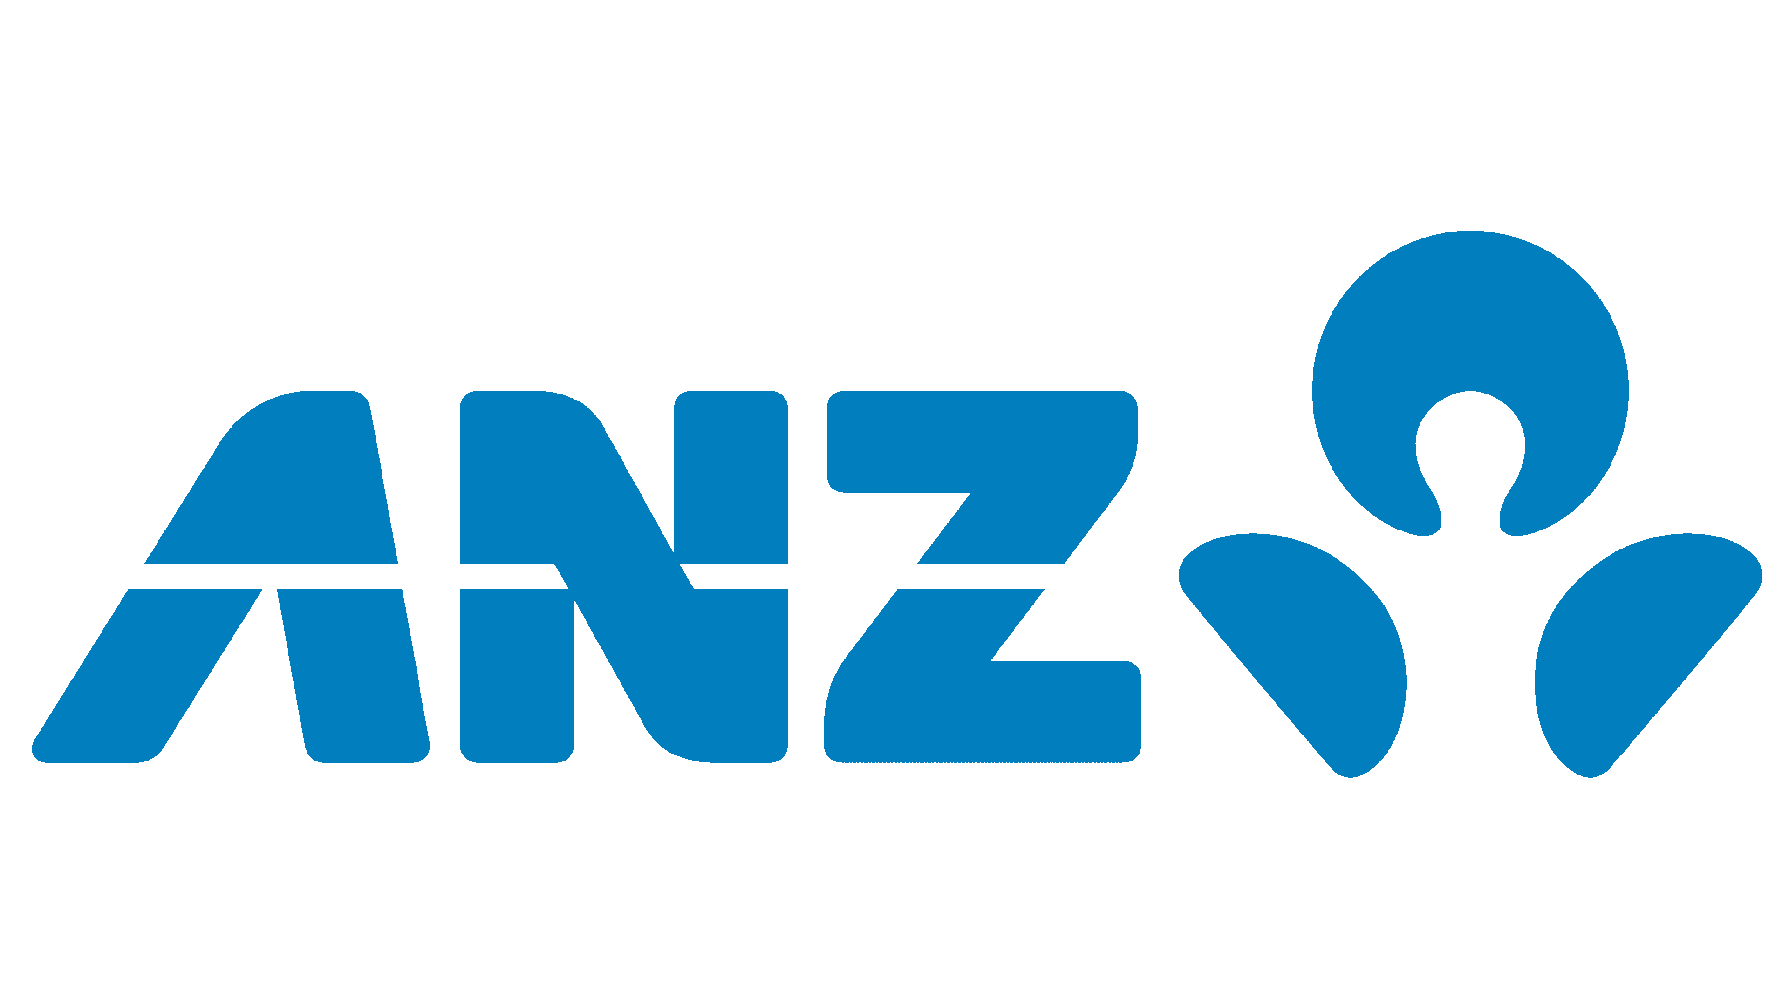








End-to-end Database DevOps
Redgate creates ingeniously simple software to help organizations and professionals get the most value out of any database, anywhere.
We help over 800,000 people in every type of organization around the world, including 92% of companies in the Fortune 100.
Notes:
Redgate is the industry standard in Database Devops tooling. Our comparison tech is the industry leading and the bar on which all others are measured.
We have been building tools across the last 20 years that companies all over the world use and depend on. From the largest F100 to many small and medium sized business. No shortage of DBAs and developers have found our tools indispensable in their daily work.

Slide 7
End To End Database DevOps

Slide 8
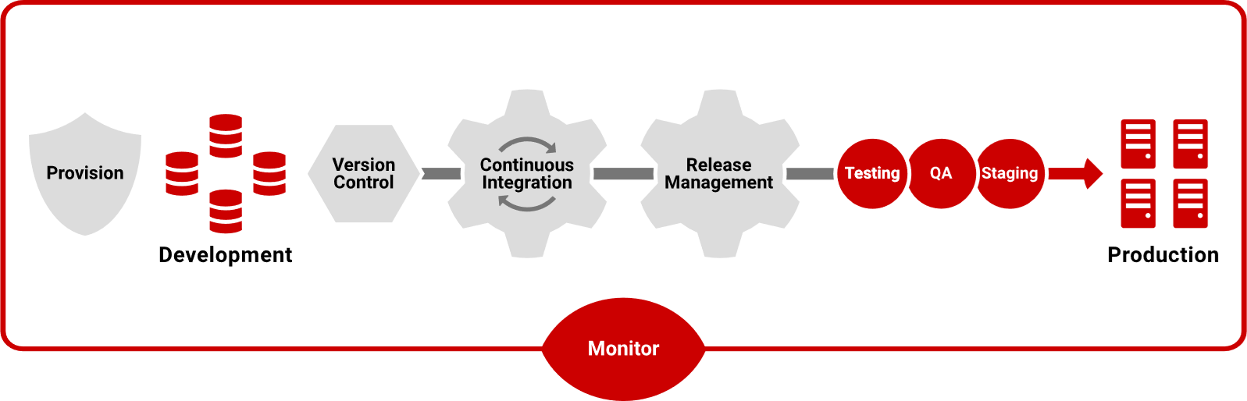
What does End-to-end Database DevOps look like?
Notes:
Walk through the lifecycle and call out the areas you are covering today

Slide 9
Database DevOps: 73% now have implemented, or intend to in the next two years
Not planning to adopt
Planning to adopt
Adopted in least some project or in PoC
Adopted across all projects
Notes:
Most of you are here because you want to work in a DevOps way. Either you are or are planning, or at least want to learn.
There has been a State of DevOps survey for quite a few years from Puppet Labs and DORA. Redgate run a survey called the State of Database DevOps each year (we didn’t in 2022). As you can see, when we started, less than ½ of the companies were adopting DevOps, but that grew to nearly ¾ in 2021. We’re holding steady at 73% in the 2023 survey – stating they have already adopted Database DevOps across all or some of their projects, or are planning to do so in the next two years. I’m sure that’s higher. Adopting better software development practices is a trend among almost all companies.
This finding is a significant highlight because it demonstrates that the understanding of the advantages of DevOps has filtered down from application development to database development. It’s also a major signal that those with slower plans or no plans to adopt DevOps for database development will fall behind their competitors by not gaining the same advantages across their business.

Slide 10
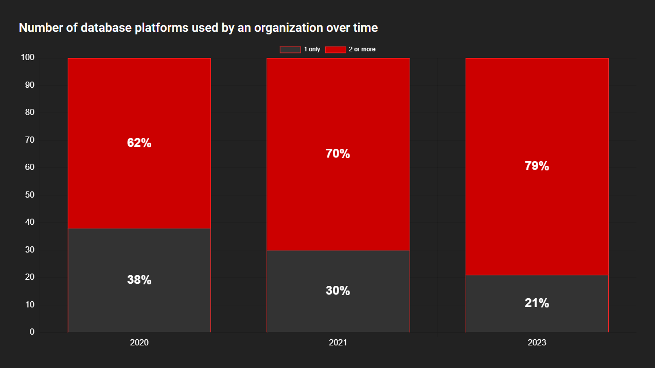
Number of database platforms in use
Notes:
As data needs change so does the infrastructure, with the majority of businesses needing different database platforms to fulfil requirements. Our data from 2020 has shown a steady increase in businesses using two or more database platforms (from 62% to 79% in 2024) with the top four being SQL Server, Oracle, MySQL and Postgres.

Slide 11
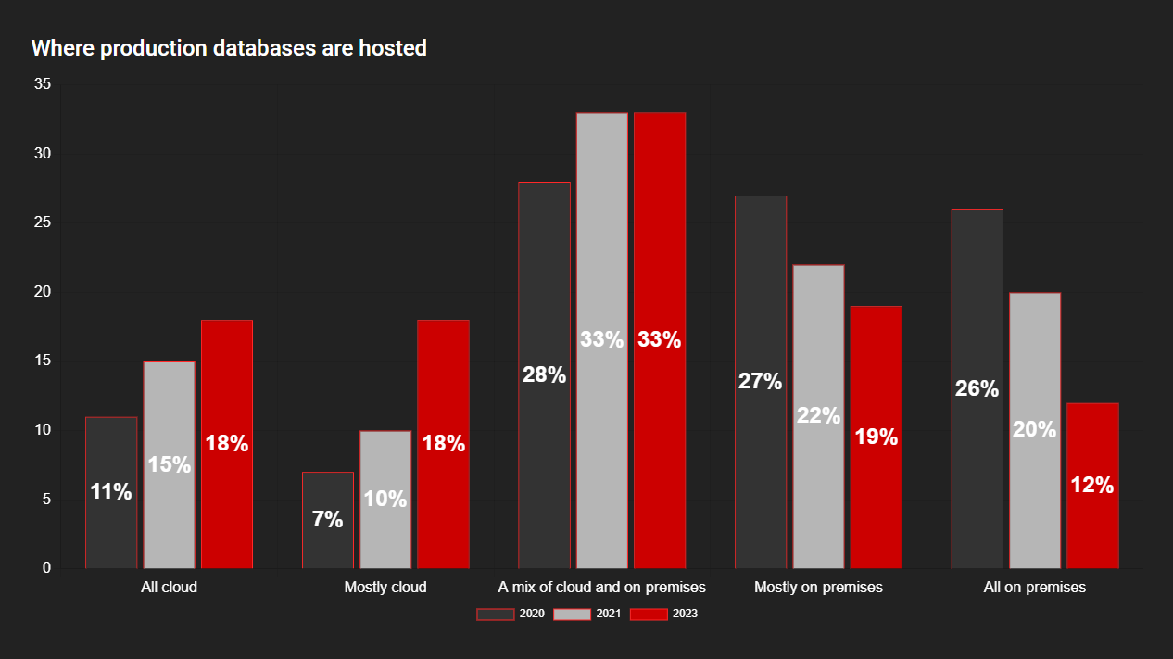
Where are you working?
Notes:
The rise of cloud adoption has been well documented and, using data from this survey along with Redgate’s previous State of Database DevOps Surveys, the ongoing trend is very clear.
The percentage of those who host their databases mostly or all in the cloud has jumped from 18% in 2020 to 36% in 2023. At the other end of the spectrum, those who host their databases mostly or all on-premises has fallen from 53% in 2020 to 31% in 2023.
Interestingly, the group of respondents sitting right in the middle show little change. In 2020, 28% were using a combination of cloud and on-premises. In 2021, this rose to 33% and in 2023 remains at 33%.
It appears that there is movement from on-premises to the cloud, but it is a staged journey, with businesses moving to a combination, finding the type of cloud set-up they prefer, and then taking the next step.
It’s worth noting that out of all the respondents who do not use cloud in any capacity, over 44% of them were from smaller enterprises (100 or less employees).

Slide 12
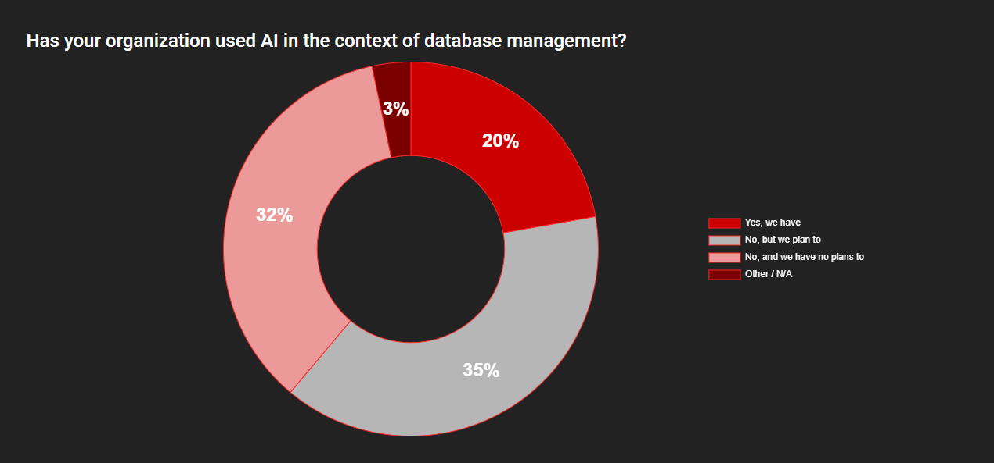
Using AI for the database
Notes:
As with any technology, each tool starts at the beginning of the adoption lifecycle; from early innovators and adopters, through to the late majority and laggards. AI is much hyped with many having high expectations of its potential. As evidenced in our survey, people are indicating that the value of AI is recognized, with 20% of respondents answering they had used AI technology in the context of database management and 35% stating they are considering adopting it in the near future.

Slide 13
So Why DevOps?

Slide 14
Speed and efficiency are the main driver to implement database DevOps
Notes:
Top of the list when considering Database DevOps is, predictably, increasing the speed of delivery in order to release value to the business faster. There are many other advantages to be gained, however, from minimizing application downtime and freeing up developers for more added value work through to increasing the protection of production databases and meeting audit and compliance requirements.
Regardless of the challenges there is huge value to be gained from adopting DevOps – call out a couple of the common goals
From Steve: I am not a speed guy in trying to make more and more releases. We’ll talk about that shortly, but for me, I need to release when I need to release. If we have a bug or security issue, we want to release today. We want to properly model the database, we want to write good code and test it. However, when we’ve done that, we want to release that code quickly. We don’t want to hold it.
Database DevOps helps us do this and deploy those changes so the application developers can go faster and meet the demands placed upon them.

Slide 15
So Why Redgate?

Slide 16
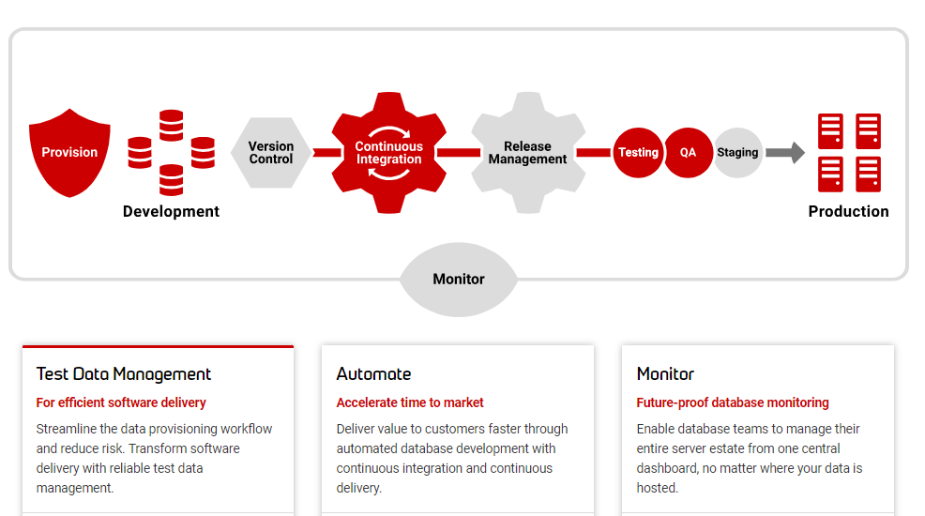
End-to-end Database DevOps

Slide 17
Test Data Management

Slide 18



Key test data challenges organizations face
Reduced efficiency
Limited automation and self-service capabilities leading to multiple ad hoc requests for data¹
Shared development and test environments
Time-consuming manual processes³
Low quality data causing release failures
Outdated or unrepresentative data causing release failures in production¹
Developer downtime due to extended waits for fresh data¹
Poor scalability & protection
Insufficient control over data access and usage, increasing risk of data breaches²
Uncertainty about data location²
Risk of regulatory non-compliance leading to fines and reputational damage¹
1. Gartner: Elevating Test Data Management for DevOps, 2018
2. Gartner: 3 Steps to Improve Test Data Management for Software Engineering, 2022
3. Gartner: DevOps Test Data Management, 2021
4. Bloor: Test Data Management, 2021
Notes:
Objective of the slide: Show we understand the specific TDM challenges that our customers are facing.
Narrative:
If the challenges around managing test data aren’t addressed, there’s a number of risks and pitfalls we end up coming up against. First up, efficiency. * If we don’t automate the provisioning of data, DBAs and Data Engineers end up managing multiple ad hoc requests, usually in a format that isn’t easy to control, like email. Or even if there is a more robust process, requests can get caught up in approval flows. * This is amplified by the challenges presented due to the practice of using share development and test environments
* These hurdles, along with time-consuming manual processes, significantly hamper efficiency.
On the quality front, we're up against a wave of release failures triggered by outdated or unrepresentative data. *This causes a ripple effect, leading to test failures in production and prolonged waits for fresh data, costing valuable developer time.
Tying this all together is the issue of data management and control. * Amid all these challenges, we grapple with maintaining sufficient control over data access and usage, ensuring data location transparency, and complying with evolving data regulations and security requirements. It's clear, these interlinked issues call for a transformative approach to how we manage our data

Slide 19
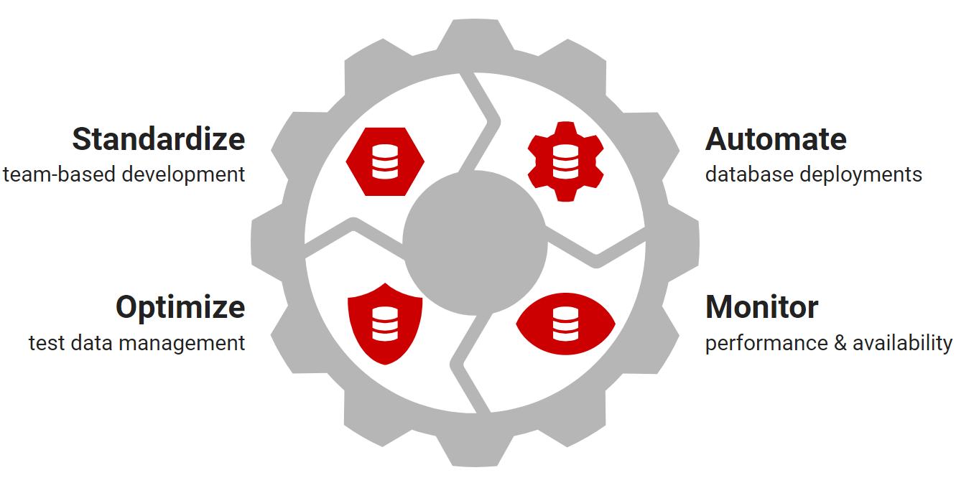
Introducing Redgate Test Data Manager
Enable test data management, transform software delivery.
Improve your release quality and reduce your risk, with the flexibility to fit your workflow.
We’ve automated and simplified reliable test data delivery to ease compliance burdens and enable developers and testers to deliver high quality software efficiently.
Notes:
Objective of the slide: : A slide to quickly pass over, give people the top level overview of our mission and the value we can bring
Narrative: So that’s where our test data management solution comes in. We’ve built a tool that helps you be smarter about application development. It automates the repetitive tasks and eases the burden of data management. But what does that mean in practice?

Slide 20



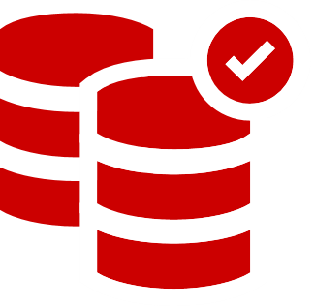


Get the data you need, however you need it
Simplify the hard stuff, with automated discovery and classification
Deterministic masking made easy
Data virtualization – from petabytes to gigabytes in seconds
Provision more than just the database with whole-instance provisioning
Serve up the perfect slice with subsetting
Conjure up data with data generation
Notes:
Objective: A top level list of the features of Redgate Test Data Manager
Simplify the hard stuff with PII discovery & classification
We've automated data discovery and classification to start protecting personally identifiable information (PII) quickly
Deterministic masking made easy
Simplify data protection with automated, deterministic masking, replacing PII with realistic alternatives that are consistent across your data estate.
Data virtualization - from petabytes to gigabytes in seconds
Create small, lightweight clones of databases using virtualization. Quick to spin up, and with PII masked.
Provision more than just the database
Whole-instance provisioning ensures that every clone is a perfect copy, including database version, operating system, and configuration.
Serve up the perfect slice with smart subsetting
Working with large datasets? Provision a slice of data in the exact size you need, with referential integrity intact.
Conjure up data with data generation
Generate realistic data tailored to your testing and development needs.

Slide 21
Standardize

Slide 22





SQL Prompt
50% faster writing SQL code
Increased efficiency of code development with customizable code snippets
Reduce errors with code analysis to discover issues
Standardize coding and improve code readability with one-click formatting
Adopt best practice and visibility with tab colouring and SQL history

Slide 23
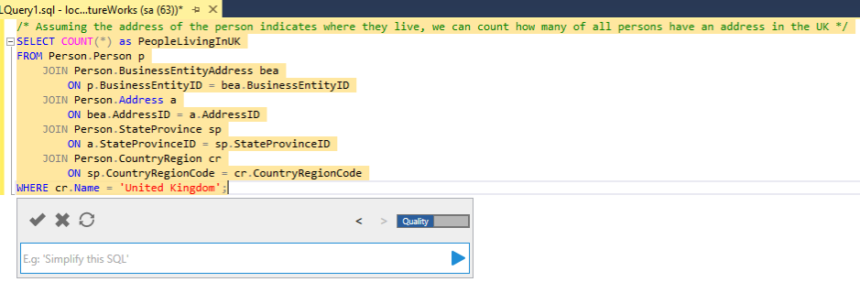
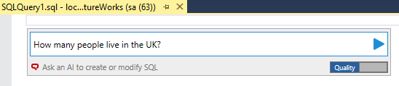
SQL Prompt+
+
=
AI
+
Query
=

Slide 24
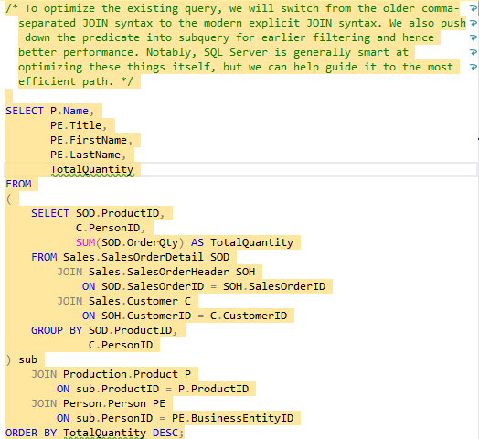
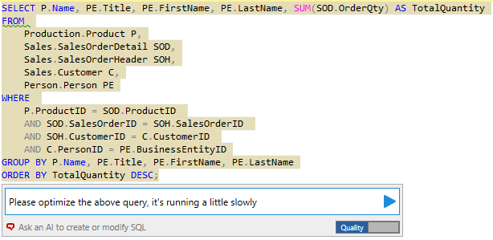
SQL Prompt+
+
=
AI
+
Optimize
=

Slide 25
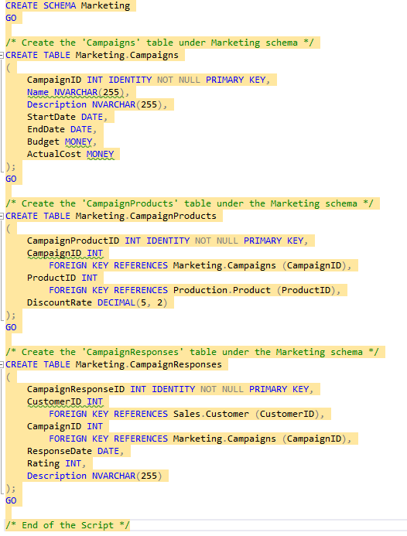
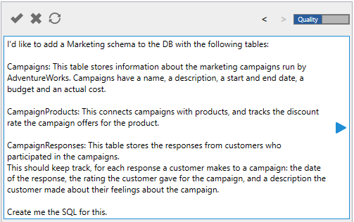
SQL Prompt+
+
=
AI
+
Create
=

Slide 26
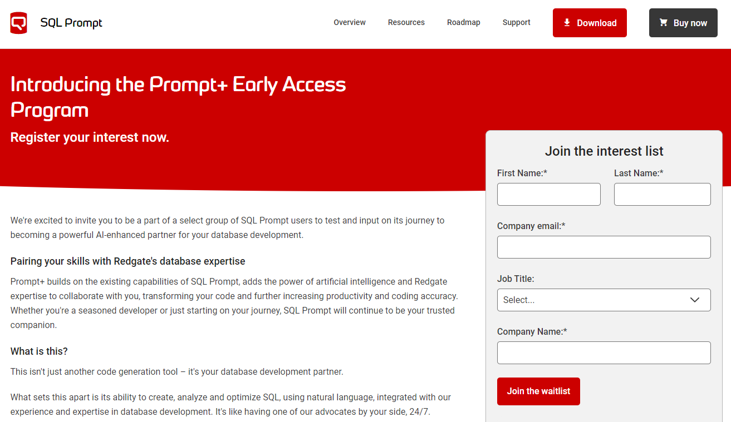
Prompt+ - Sign up for the EAP
www.red-gate.com/promptpluseap

Slide 27
Automation

Slide 28



Achieve continuous delivery with these 3 Database DevOps practices
Version
control
Continuous integration
Repeatable deployments
Notes:
And this can be achieved by introducing DevOps best practices:
Version control to assign a version to every change that is made to the database. So you know when and who made the change and can shorten the feedback loop
Repeatable deployments: using the same process and approach for every deployments (this includes choosing which development model to follow: State based, migrations based or hybrid. This allows to have a consistent approach that reduces potential risks
Continuous integration to move a committed changed to a pre-defined pipeline and perform various tests increasing the quality of successful candidates and mirror the application process

Slide 29

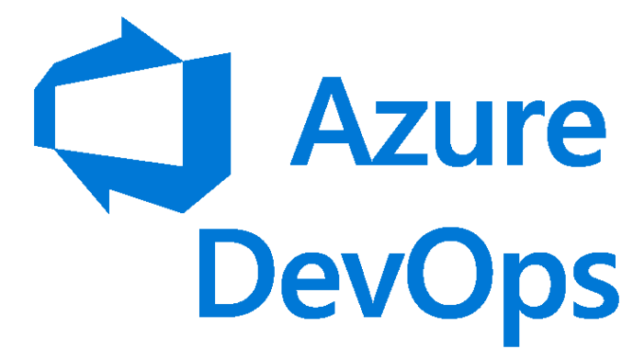



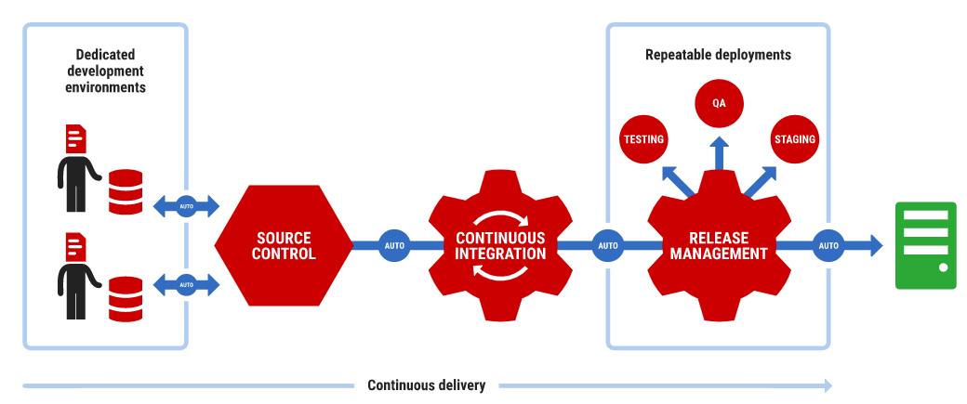


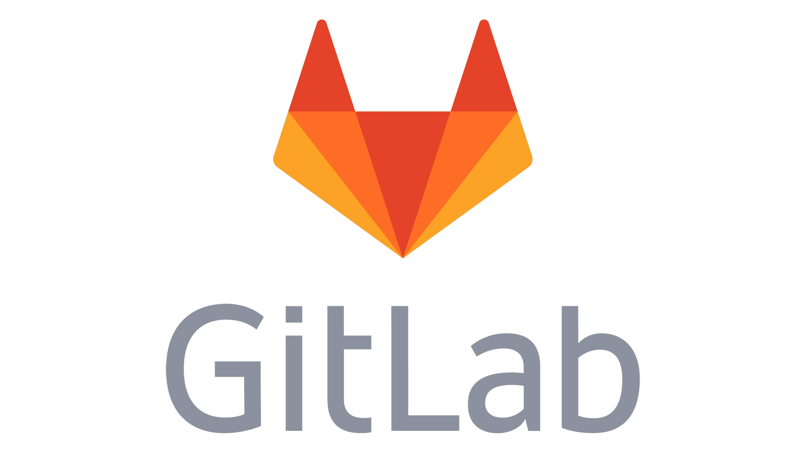



Flyway Enterprise

Slide 30




Advanced features support the end-to-end deployment process for SQL Server, Oracle, PostgreSQL and MySQL
Object-level history
Repeatable deployments
Migration script auto-generation
Drift detection, reporting & SQL code standard checks
Continuous integration
Migrations, state, and hybrid development models
Notes:
And for SQL Server, Oracle, PostgreSQL and MySQL we offer advanced functionalities that enable with automation the end to end release process.

Slide 31
Where would you put yourself on the maturity model?

Slide 32
Database Monitoring

Slide 33

| Monitor database performance and availability
Manage your entire database estate from a central view. Proactively mitigate potential risks and optimize database performance with instant problem diagnosis and customizable alerting – wherever your servers are hosted.
Top 4 business challenges Redgate SQL Monitor solves: .
Diagnosing and resolving issues
Minimizing downtime
Optimizing performance
Keeping pace with expanding server estates

Slide 34
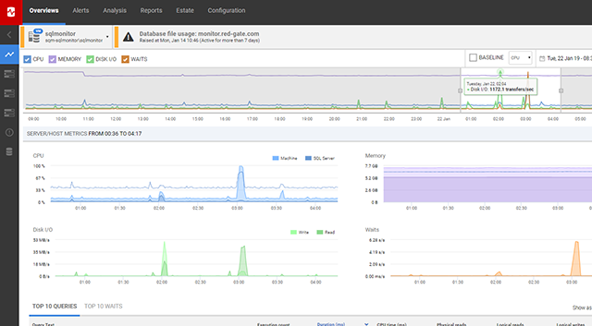
| Proactively monitor your growing database estate
Get an estate-wide overview with fast deep-dive analysis
Overview - A single pane of glass for your entire database estate
Scalable - Monitoring that grows and adapts with your estate
Diagnosis - Find root causes in seconds and get guidance on how to fix them
Performance - Know what has the biggest impact and make improvements
Alerting - Immediate alerts tailored to your needs

Slide 35
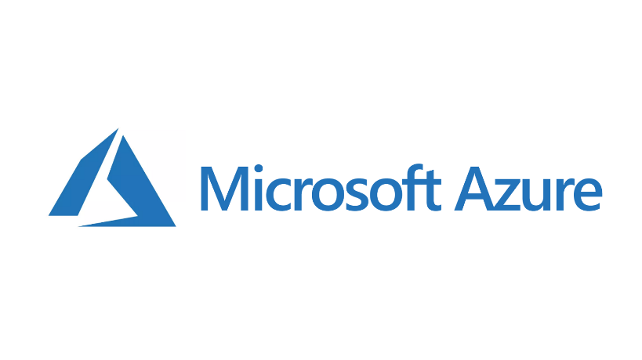


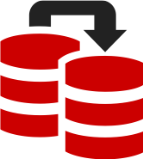
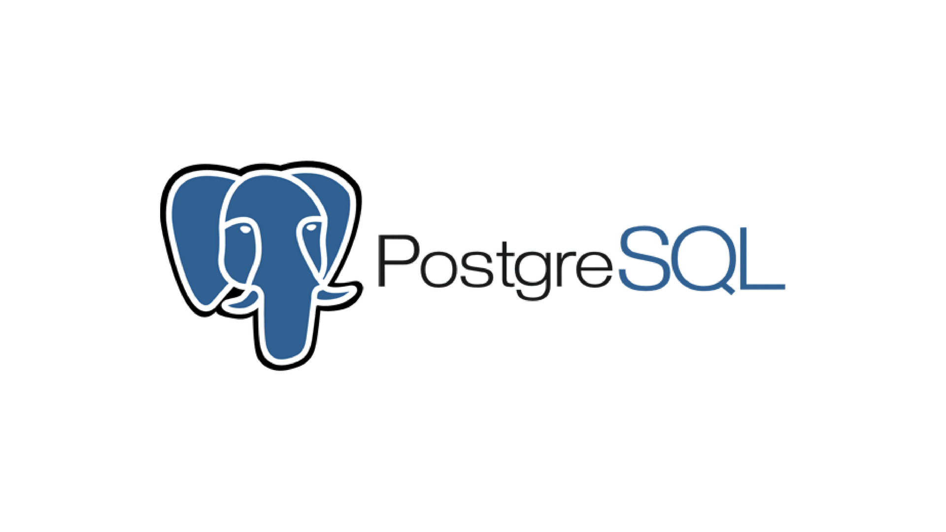


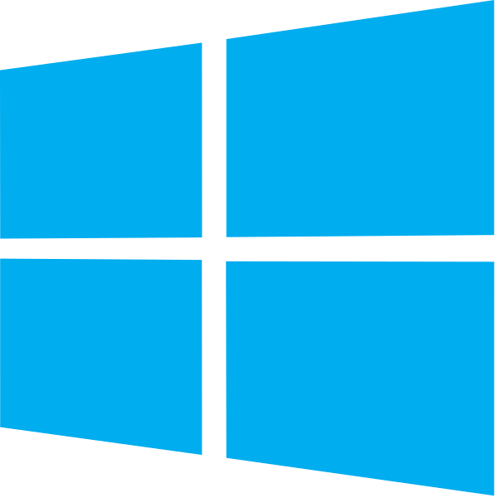


| What can I monitor?
Azure SQL Database
Azure Elastic Pools
Azure Managed Instances
Clusters
2008 - vNext
Availability Groups
v 10+
Amazon RDS
Virtual Machines
Windows
Amazon EC2
Google Cloud CE

Slide 36
2024 Roadmaps

Slide 37
| Product Vision and Roadmap
Manage large estates and automate monitoring processes across different technologies
2023
PostgreSQL support
More diagnostic and performance info, e.g. index and schema changes
Additional cloud specific metrics and information
2024+
Support for additional RDBMSs
Enhanced workflows for common DBA scenarios
New reporting capabilities
Notes:
Subject to change, see https://www.red-gate.com/products/dba/sql-monitor/roadmap for up-to-date product roadmap.

Slide 38
Flyway roadmap
Automate database deployments across teams and technologies
2024
50+ database platforms covered by Flyway:
Advanced capabilities: MariaDB, EnterpriseDB and Percona (Snowflake and TimescaleDB in preview)
Foundational capabilities: MongoDB, ClickHouse, Databricks (Cassandra and Amazon DocumentDB in preview)
Static data for Postgres
Command line support comes out of preview for tasks surfaced in Flyway Desktop
Including automated project set-up, baseline and script generation
Selective migration script deployment in Flyway Desktop
Bringing the flexibility to define rules that allow selected migration scripts to be deployed against specific environments
Notes:
Objective of the slide: Show what we’re working on, and what’s to come

Slide 39
Roadmap
Enable test data management, transform software delivery
2024
Rapidly sync data
Frequently sync your development and test environments to reflect production with quick, incremental updates
AI synthetic data generation
Using the power of AI, curate the data you need, when you need it
Support for PaaS and Cloud databases
Additional flexibility to work with your data, wherever it is
Existing capability improvements
Automatic classification, masking, smart subsetting, virtualisation, integrations & workflow
Notes:
Objective of the slide: Show what we’re working on, and what’s to come Narrative:
Rapidly sync data – we're introducing the ability to create incremental images, which means that if production gets updated, it's quick and easy to reflect those updates in any dev and test environments – without having to take a new full back up of production.
AI synthetic data generation – using AI to improve the synthetic data generation capabilities. So you can create whatever data you need without dependencies on production.
Support for PaaS and Cloud databases – Increasing the integration of our capabilities so we can support your test data management challenges no matter where your database is – including PaaS and Cloud databases
Existing capability improvements - We'll continue to build on our existing capabilities including how they integrate with each other and the end-to-end workflow

Slide 40
Next Steps

Slide 41




Next Steps
All the resources you need to get you and your team up and running
Redgate University
Self-paced online training courses
Technical articles
written by the industry experts
Thriving
forums
of SQL Server professionals
Events programme
of webinars, live streams & summits
Community websites
such as Simple Talk and SQL Server Central
Notes:
A lot of support is available – a real community

Slide 42


Maximize value with Redgate Professional Services
Instructor Led Training
1, 2 & 3 day training courses – remote interactive sessions
Prepared content, combination of lessons & hands on labs
1
Guided Installation
Requirements gathering & technical documentation
Expert installation support via remote session
1
Configuration
Scope definition & implementation plan
Technical configuration delivery
1
Notes:
Our professional services are designed to help you succeed and maximize the value from your Redgate solutions.
We offer instructor led training – where you have a choice of 1, 2 & 3 day training courses.
These consist of remote, interactive sessions enabling you to cost effectively get your teams together to learn
The combination of lessons + hands on exercises is designed to disseminate prepared content at a consumable pace, ensuring your teams are kept up to date – driving greater engagement, knowledge transfer and increased adoption of your Redgate solution
Our guided installation package will help you get started and get to value faster.
Our experts will work with you to gather your requirements and produce technical scope documentation
And provide guidance and hands on support to help you install the solution via a remote session
And finally, we have a configuration package that is designed to help you implement and configure your Redgate solution in line with evolving business needs.
We will work with you to understand your specific needs and define the scope of work. This will be documented in an implementation plan
And we will deliver the technical configuration in line with the implementation plan – this can either be a remote session where a Redgate Consultant will pair with your team and provide expert guidance to apply technical changes, or it can be a Redgate Consultant working in isolation (i.e. writing technical scripts)

Slide 43
You get more with Premium Support
Accelerated Support | Standard | Premium
24x7 Coverage (P1) | x | ✓
24x5 Coverage (P2-P4) | x | ✓
Wknd / Hol Support (P1) | x | ✓
Multi-channel Req. Mgt | x | ✓
Faster Response Times | x | ✓
Jump to L3/SME | x | ✓
Priority Case Review | x | ✓
Quarterly Report | x | ✓
Proactive Support | Standard | Premium
Architecture Review | x | ✓
Upgrade Support | x | ✓
Enablement | Standard | Premium
Webinars | x | ✓
Online Training Resources | ✓ | ✓
✓
Included
x
Not Included
Notes:
Slide Objective: To showcase the Premium Support offering, and the additional elements customers get when compared to Standard Support.
You get more with Redgate Premium Support. As you can see, it’s a much fuller offering (when compared to our standard support).
Looking to the left, you have accelerated support elements which will ensure that we respond to your issues faster.
These include: ​
- 24x7 coverage and weekend & holiday support for P1 issues – which we have not offered before​
- 24x5 coverage for P2-P4 issues​
- Faster response times - with premium support we are offering 1 Hr for P1 issues
- Jump to L3/SME, where customers skip directly to the expert best placed to resolve their issues – this is also another first for us​
- Priority case review and multi-channel request management via the support portal, email, phone
- And finally, a quarterly report, which summarizes the issues you have encountered, number of tickets resolved and ongoing, average response time, etc.
​
Looking to the right, you can see there are proactive elements like Architecture Review and Upgrade Support to proactively manage issue prevention and optimise solution performance, driving ongoing value for you and your organisation. ​
​
And finally, our enablement elements are designed to improve your teams’ knowledge and self-sufficiency. The webinars include sessions such as ‘Ask me Anything’ and ‘Troubleshooting Common Issues’ webinars with Redgate’s SMEs. As a premium support customer you will also have access to the same online resources as in standard or bespoke support, such as forums, blogs, Redgate Uni etc.​
​

Slide 44
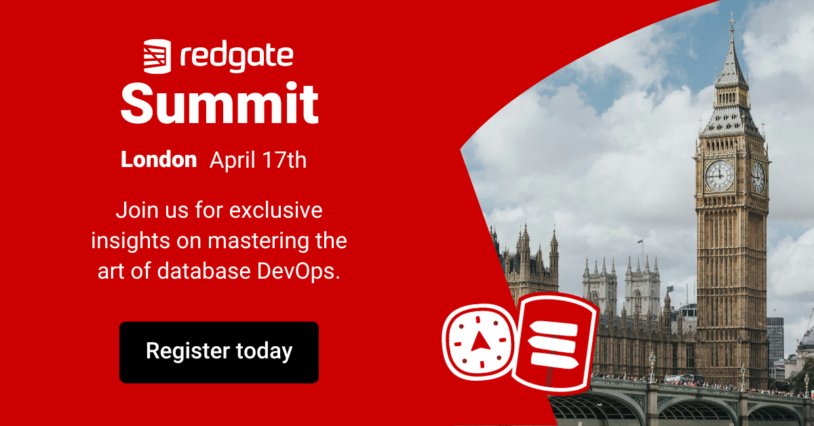

Slide 45

Redgate Events
To see what other events we have coming up, please visit
www.red-gate.com/hub/events

Slide 46
Any Questions? Thank you

